Slide 1

Graph Visualization - Tensorboard

Slide 2
Reference
Chapter 9 (O'Reilly) of Hands-On ML
Youtube on Graph Visualization - tfgraphviz
Youtube
Code

Slide 3
Data

Slide 4
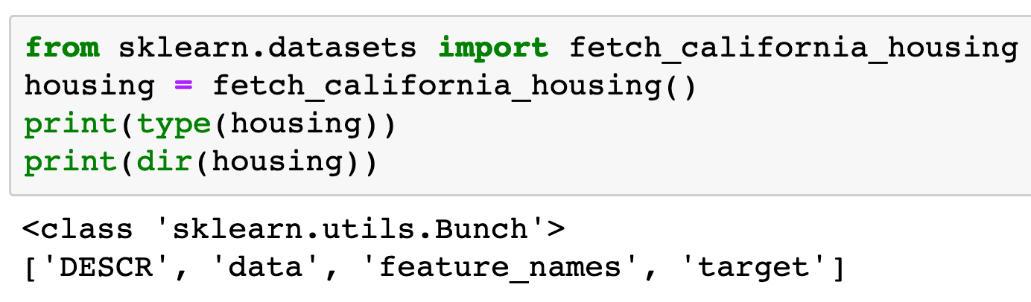

Slide 5
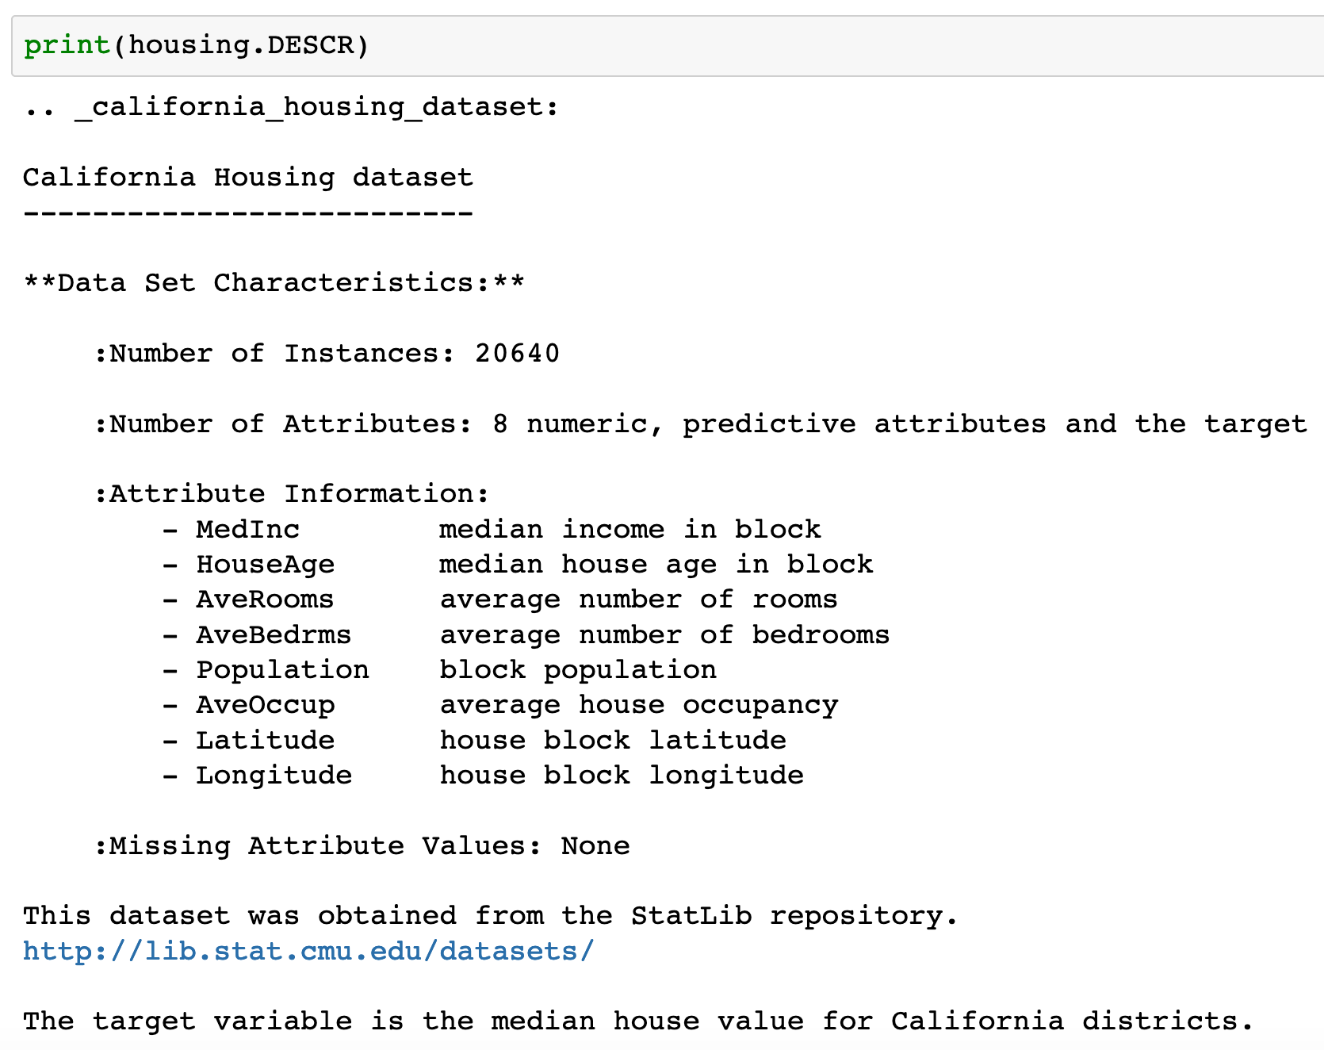

Slide 6
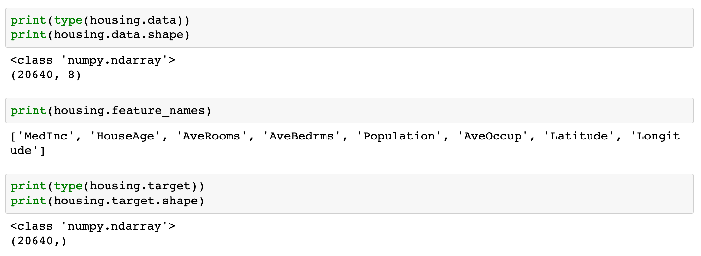

Slide 7
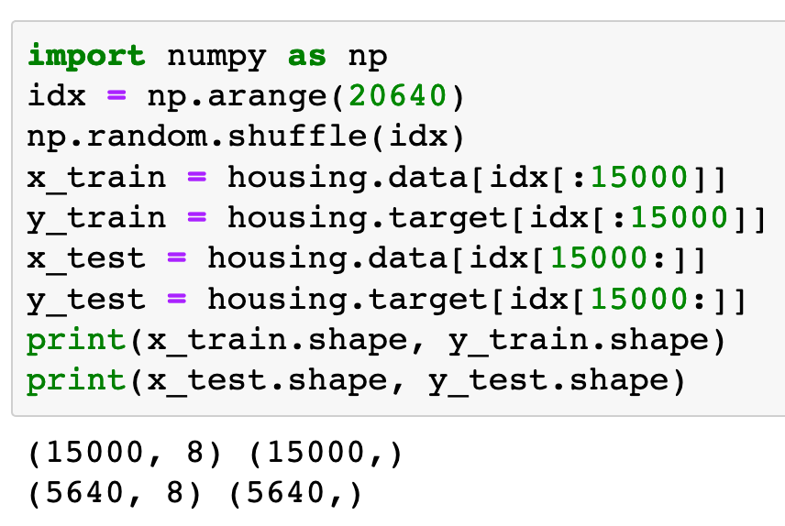

Slide 8
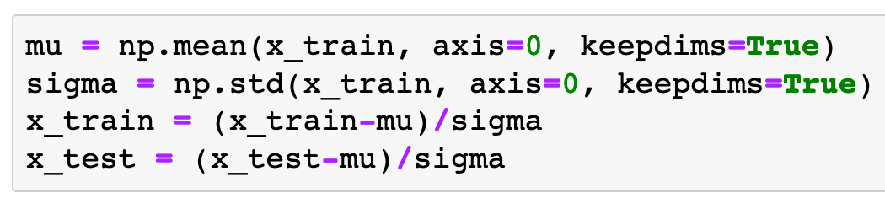
Input Normalization

Slide 9
Warm Up

Slide 10
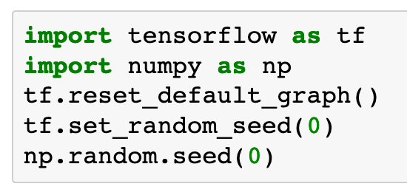

Slide 11
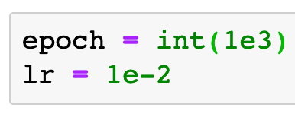

Slide 12
Graph

Slide 13
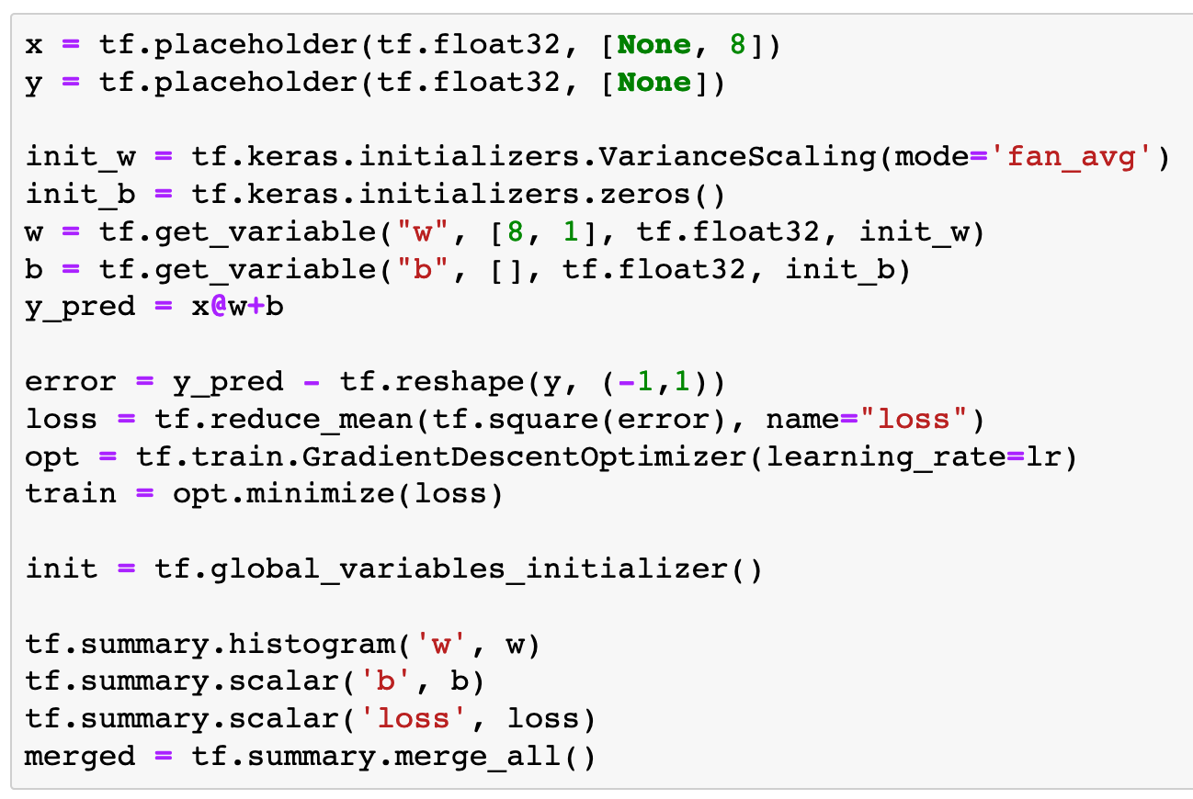

Slide 14
histogram is for tensors with rank >= 1

Slide 15
histogram is for tensors with rank >= 1
scalar is for tensors with rank 0

Slide 16
histogram is for tensors with rank >= 1
scalar is for tensors with rank 0
scalar is for tensors with rank 0

Slide 17
histogram is for tensors with rank >= 1
scalar is for tensors with rank 0
scalar is for tensors with rank 0
merge all

Slide 18
Session

Slide 19
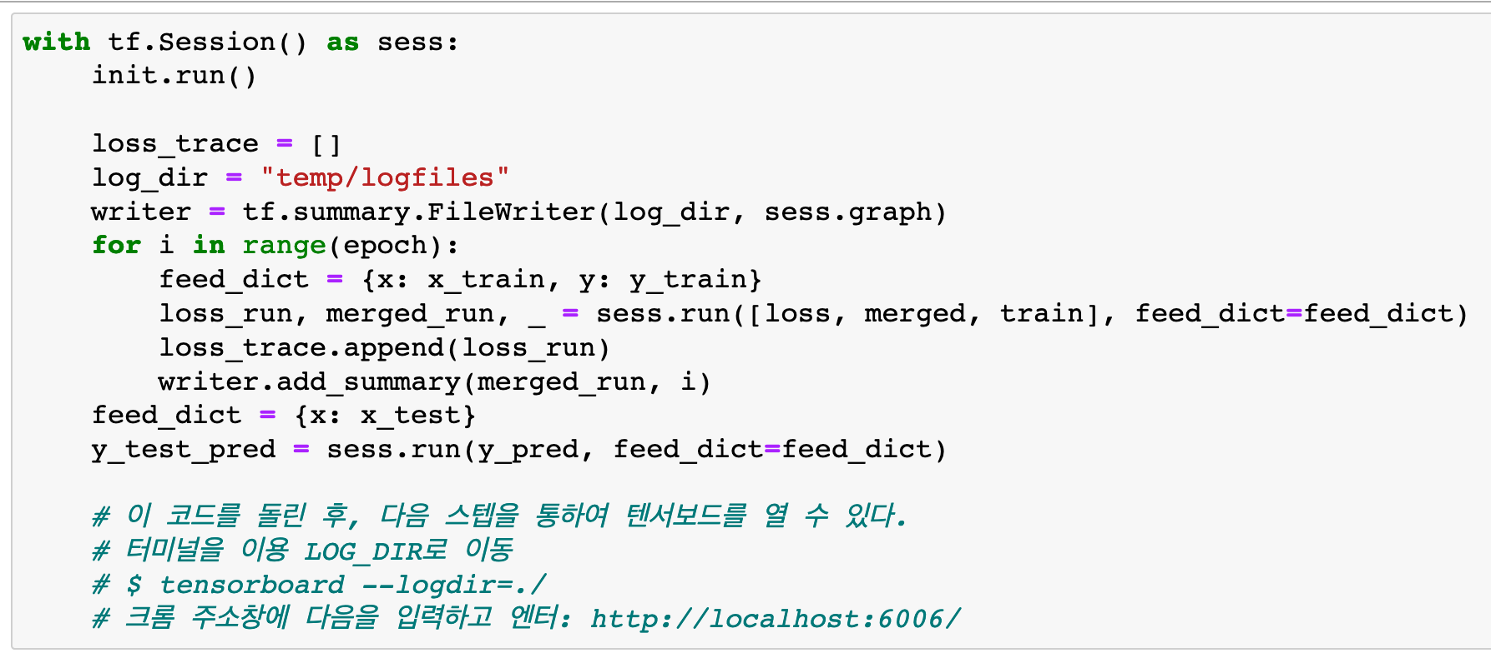

Slide 20
make writer

Slide 21
compute current values to write

Slide 22
write

Slide 23
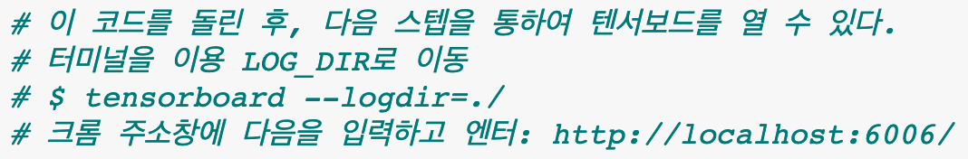

Slide 24
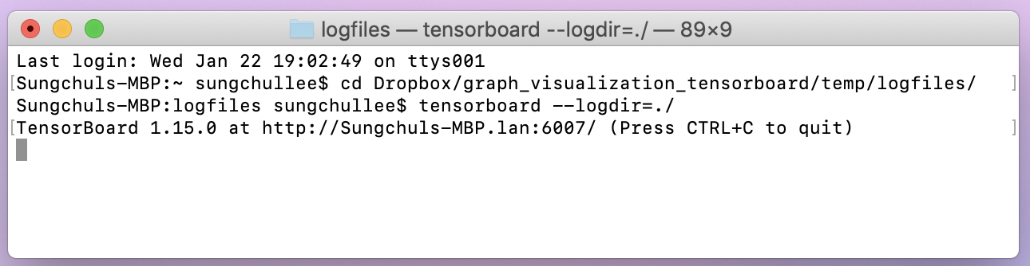

Slide 25
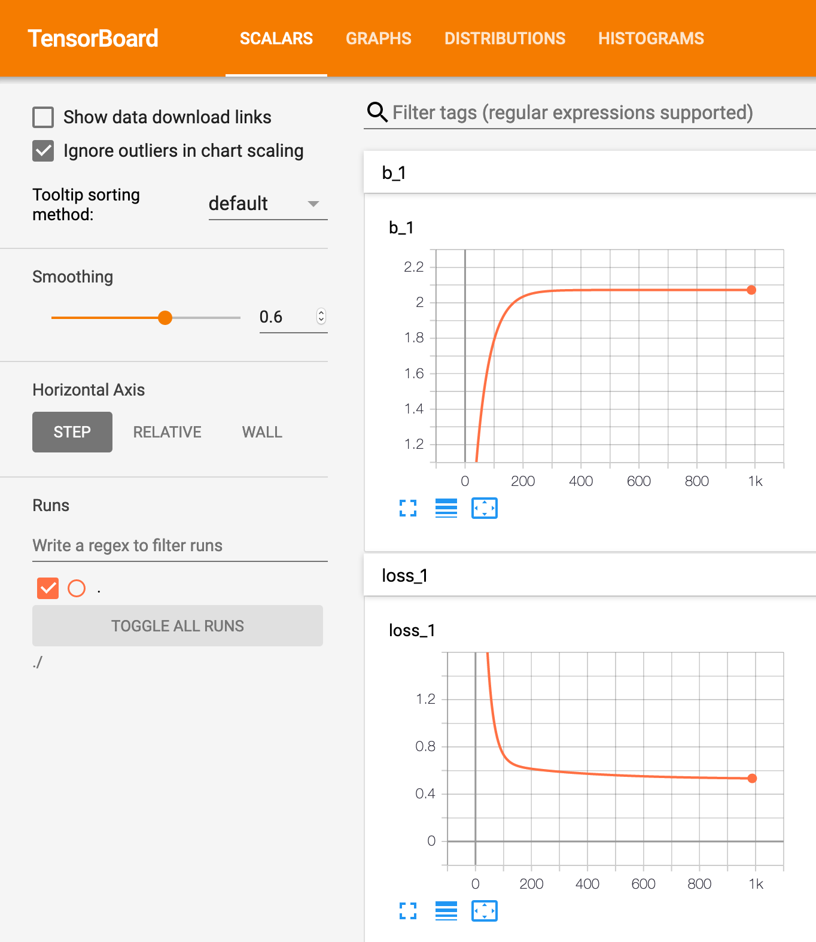

Slide 26
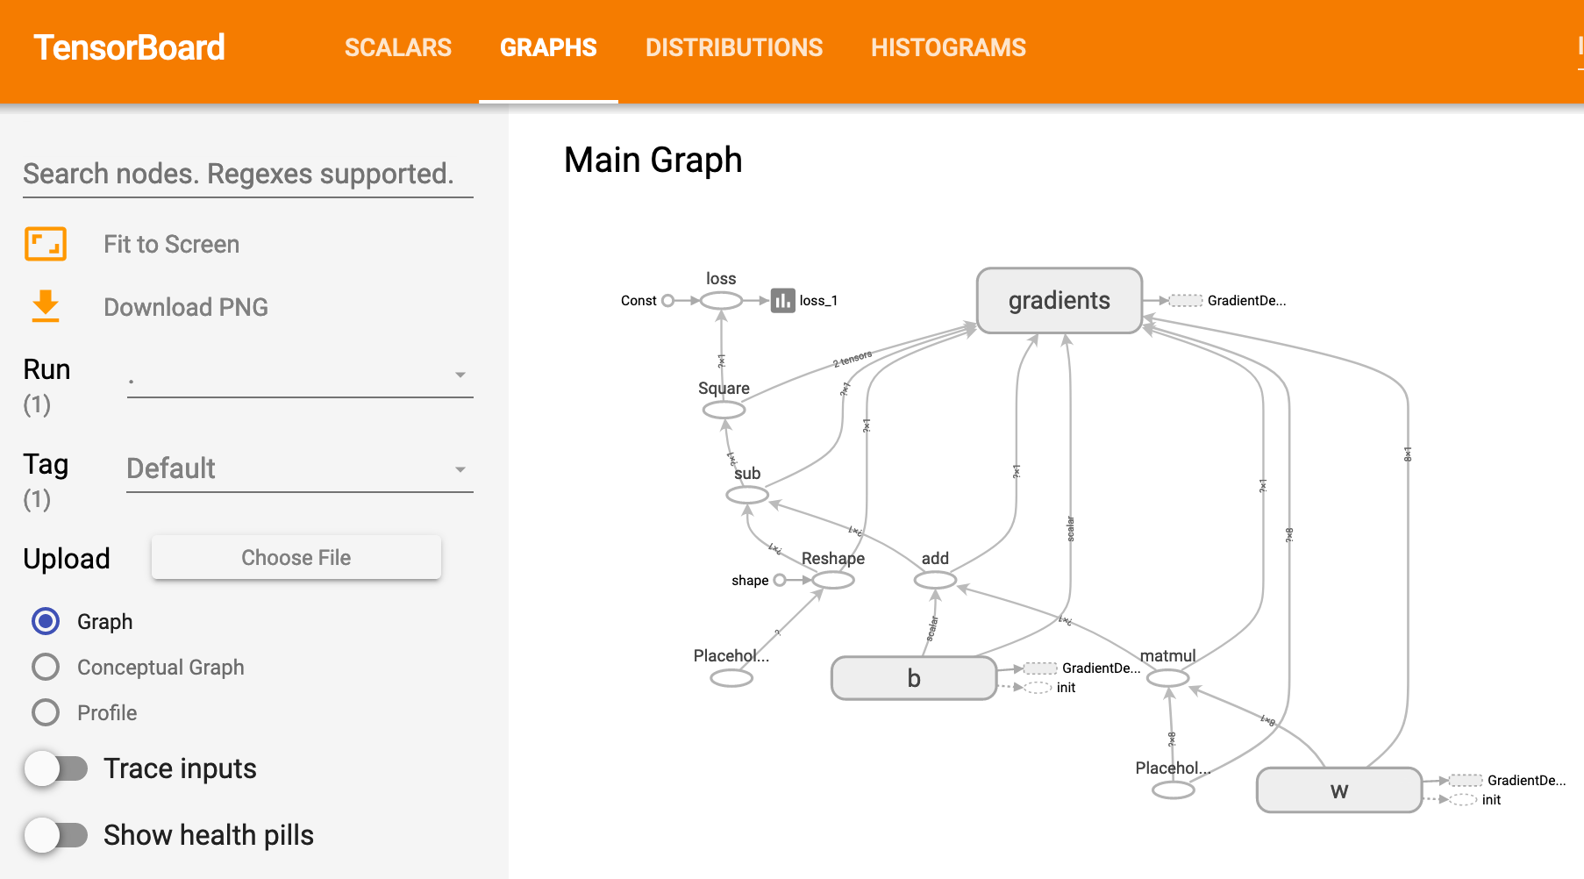

Slide 27
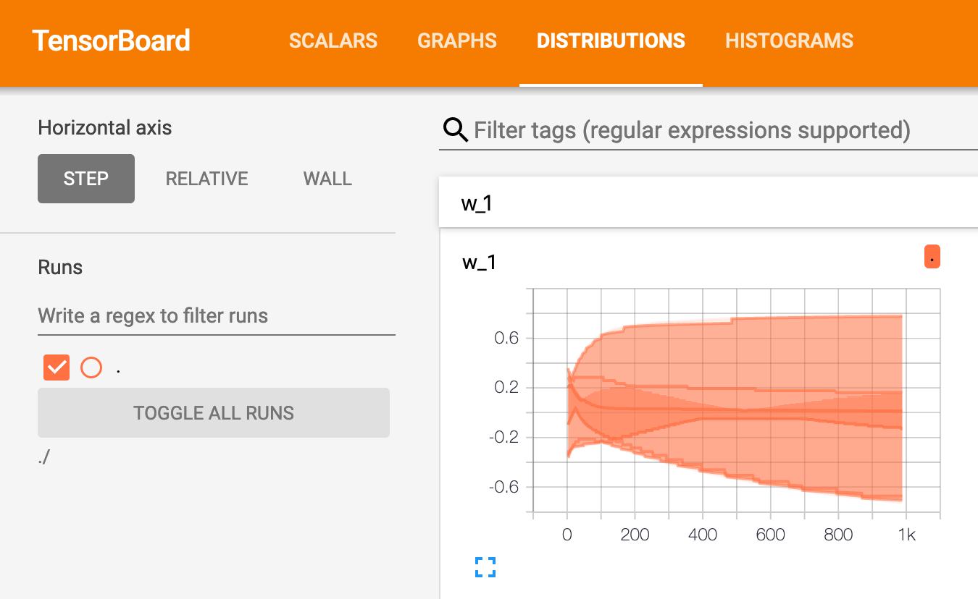

Slide 28
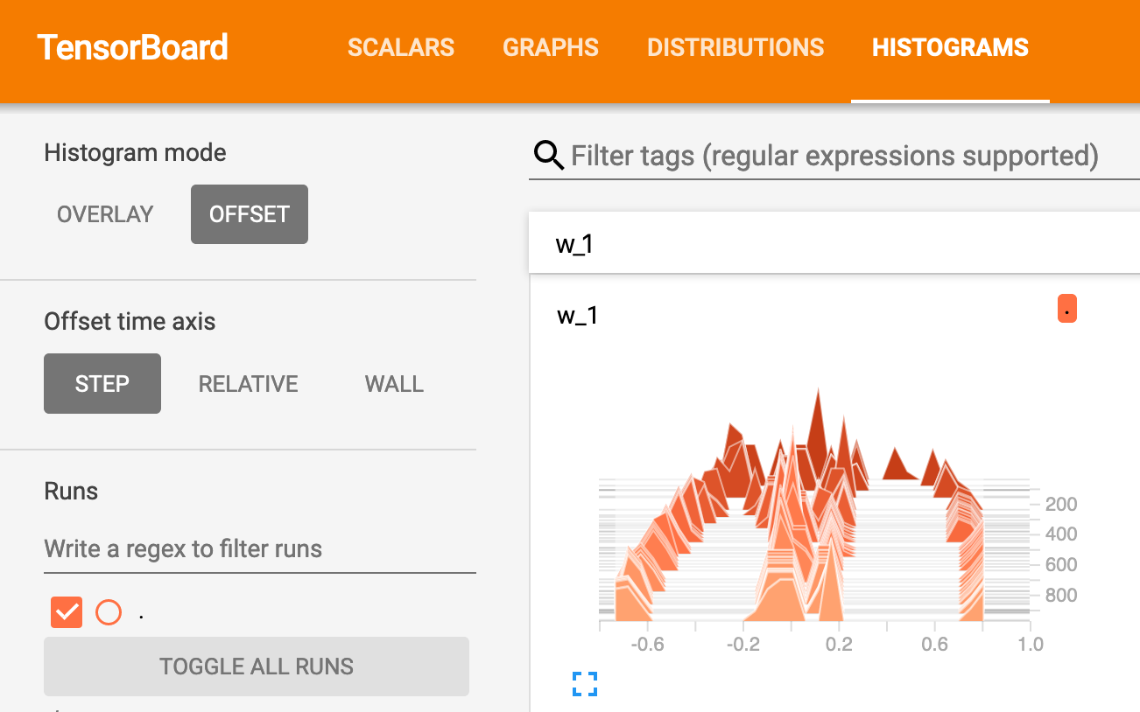

Slide 29
Report

Slide 30
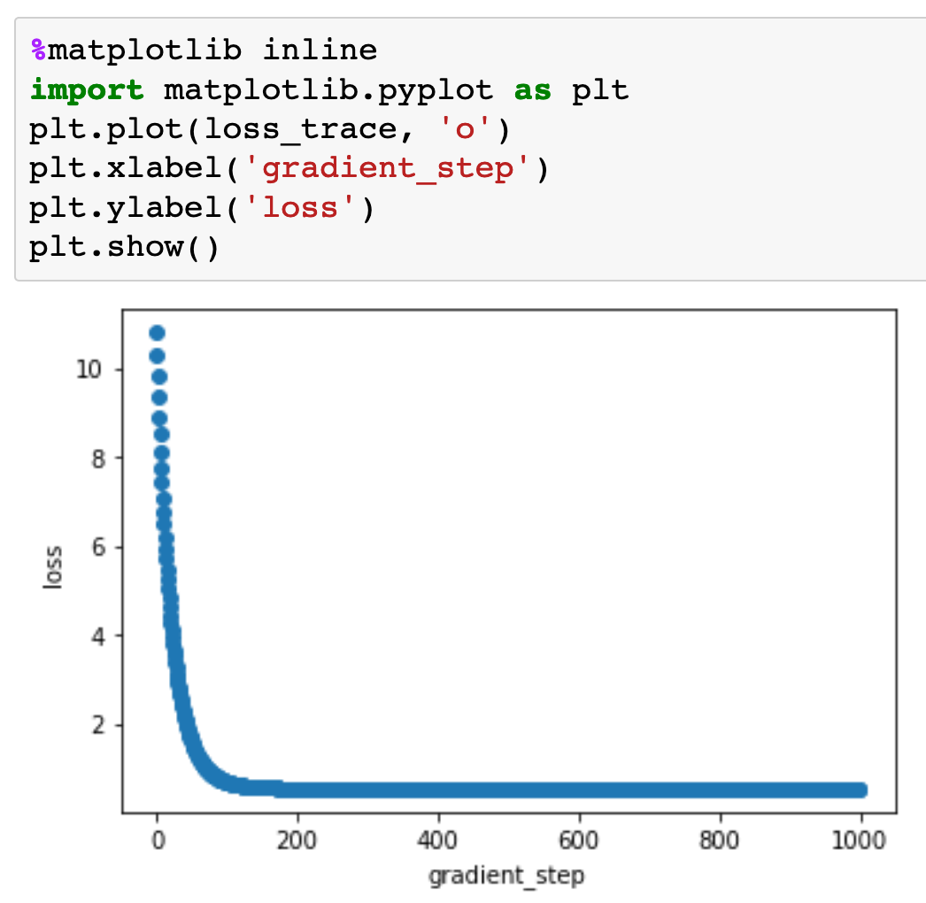

Slide 31
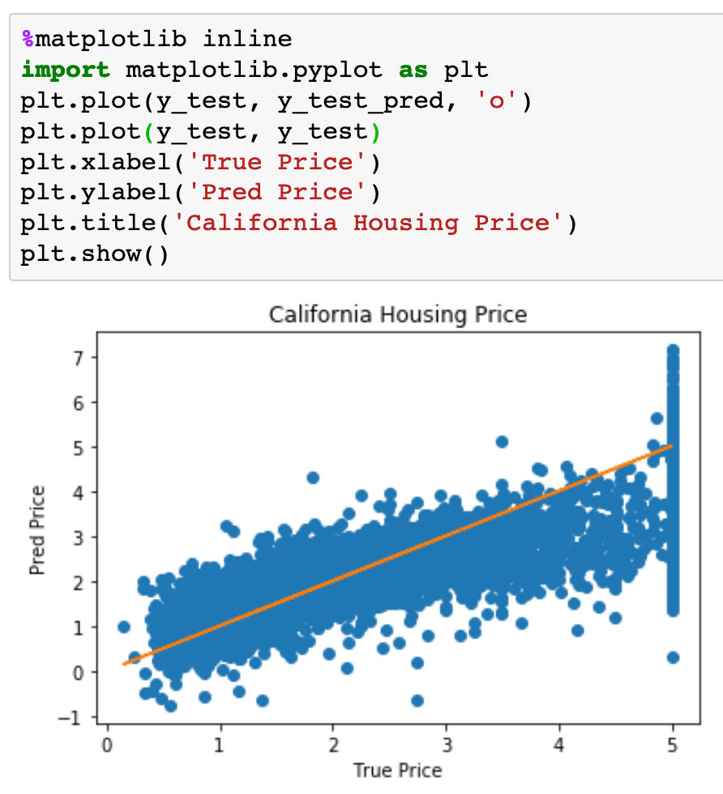

Slide 32
Now
Let’s Play with Code

